Slide 1
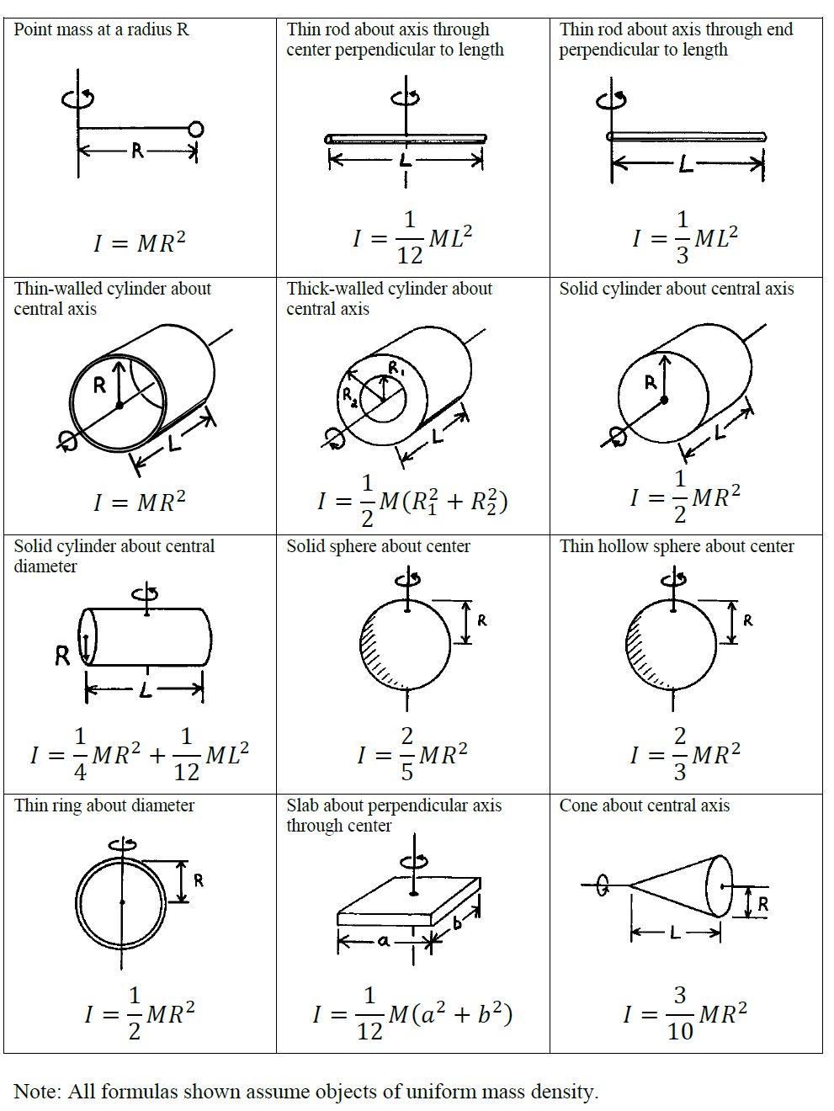
Physics 3 – Sept 19, 2019
P3 Challenge – (Repeat in your notebook – needed for notes)
  Determine and rank the moment of inertias from smallest to largest for a) a solid sphere, b) a thin hollow sphere, c) a solid cylinder, and d) a hollow tube if the mass of all four is equal to 2.5 kg and the radius of each is 15 cm.

Slide 2
Objectives/Agenda/Assignment
Objective:
  B.1 Rigid bodies and rotational dynamics (1.6 – 1.7, 1.9 – 1.10)
Agenda:
  Rolling
  Work and Power
  Angular Momentum
Assignment:
    Read/reread p1-15. Do p16 #8 and 12, 14-17

Slide 3
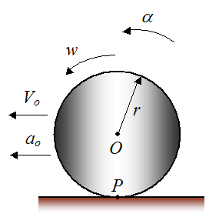
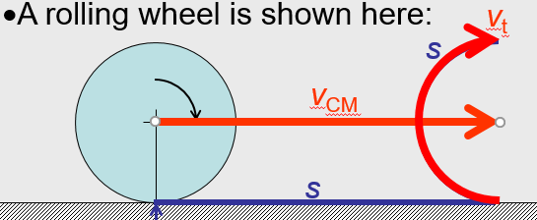
Rolling
When an object rolls without slipping or skidding it is said to be in a pure roll.
A slip is when there is no traction at the bottom of the roll and you get too much rotation, like when your tires spin on ice.
A skid is when the bottom of the roll doesn’t rotate like is should, like when your brakes lock up and you skid on the road without your tires spinning.
A pure roll is when there is a perfect match between rolling and moving forward such that the velocity of the center of mass, v_{CM}, is equal to the tangential velocity, v_{t}.
https://www.youtube.com/watch?v=XPUuF_dECVI (First 14 min)

Slide 4
Rolling Problems
Let us find the velocity of our four shapes after rolling down an incline from a height of 40 cm, starting from rest, using energy methods.
  Before we find the answers what do you think the ranking of shapes will be from the slowest to the fastest speeds? Refer to what we learned in the video.
A rolling object has both translational kinetic energy and rotational kinetic energy.
E_{T} = ½ mv² + ½ I ² where  = v/r

Slide 5
Work and Power
For work and power the analogy of variables continues:
Linear motion Rotational motion
F = ma Γ = Iα
W = F Δs W = Γ Δθ
P = Fv P = Γω
The work kinetic energy theorem also holds:
W = ½ Iω² - ½ Iω²

Slide 6

Rotational Work Problem
How much work is done on a ship’s wheel by a sailor if a constant 45.0 N force is applied tangentially while the wheel is turned 30 from rest? Let the radius of the wheel be 58.0 cm. Let the rotational inertia of the wheel be 6.50 kg m².
If this is the only force present, how fast would the wheel be spinning after the sailor lets go? Consider a rotational Work-KE Theorem.

Slide 7
Angular momentum
Angular momentum completes the set of rotational analogies.
Linear momentum p = mv
Angular momentum L = Iω
Conservation of angular momentum is the third great conservation of motion kind of laws. (The other two being conservation of energy and conservation of momentum.)
As a result of conservation of angular momentum, objects which have a change in their moment of inertia will spin either slower (increase in I – more mass far away from axis of rotation) or faster (decrease in I – more mass close to the axis of rotation.)
E.g. Consider an ice skater spinning. How does the skater use the conservation of angular momentum to increase their angular speed?
https://youtu.be/VmeM0BNnGR0 Skater video

Slide 8
Angular momentum problem
Predict the angular speed of Earth if it became a black hole. Assume the earth is a solid homogenous sphere with R = 6.37 ×10⁶ m and it would have a radius of 8.86 mm as a black hole.

Slide 9
Exit slip and homework
  Exit Slip – Three objects are in a race down a slope: a small dense solid metal cylinder, a large wooden disc, and a marble. Describe the results of this race.
  What’s due? (homework for a homework check next class)
    Read/reread p1-15.Do p16 #8 and 12 , 14 - 17
  What’s next? (What to read to prepare for the next class)
    Begin review for rotation test Thursday Sept 26

